Slide 1

Advisor
Dr. Maha Alabuljalil
Group Members
Amna Almutairi 2131110038
Asmaa Sultan 2151117051

Slide 2
Acknowledgements
The team would like to thank our advisor for her valuable vision that helped bring forth the motivation behind the project. And her efforts to support us throughout the software development. And to extend thanks to the committee for their valuable time to answer our questions and provide valuable feedback and guidance. We also thank our friends and families for their support and encouragement.

Slide 3
Introduction
The vital presence of universities in our modern life dictates that we must make their experience as smooth as can be for our students and future workforce.
From that belief, we picked up the initiative to create a student course advisory website specific to the department of Computer Science at Kuwait University.
The project includes developing the Django web-app Scheduly meant to deal with Computer Science students, instructors, and staff. What it does is provide those parties with a smart way to plan next semester course schedule.
To offer students a suggested plan so they can make informed decisions. And to digitally communicate information between the faculty and the student.
The agile development methodology Extreme Programming guided us throughout the many phases of this project. From planning, analysis, design, implementation, and testing, to deployment.

Slide 4
What we’ll talk about
Background
System Requirements
How did we get them and what we got
System Architecture
System Design
System Implementation
System Testing

Slide 5
Background
Computer Science department students at Kuwait University used traditional methods to plan for courses.
While most students needed to approach the student advisor in their early years, the student advisor reported this was not the case and that this problem was very common
By the time the students approached them it was too late to have an efficient plan.
The team decided to formulate an automated solution for this problem.

Slide 6
System Requirements
Approaches:
Inception
Elicitation
Elaboration
Negotiation
Specification
Validation
Sources:
Brain storming
Focus Group
Interviews

Slide 7
System Functional Requirements
Students
Instructors
Supervisor
Admin
Registration
Login
Input to system
Output to system

Slide 8
System Non-functional Requirements
Security
Reliability
Usability
Scalability

Slide 9
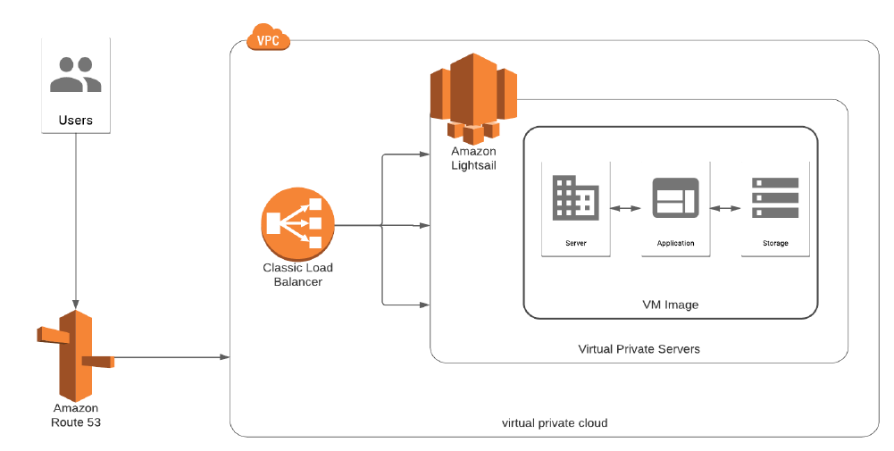

Slide 10
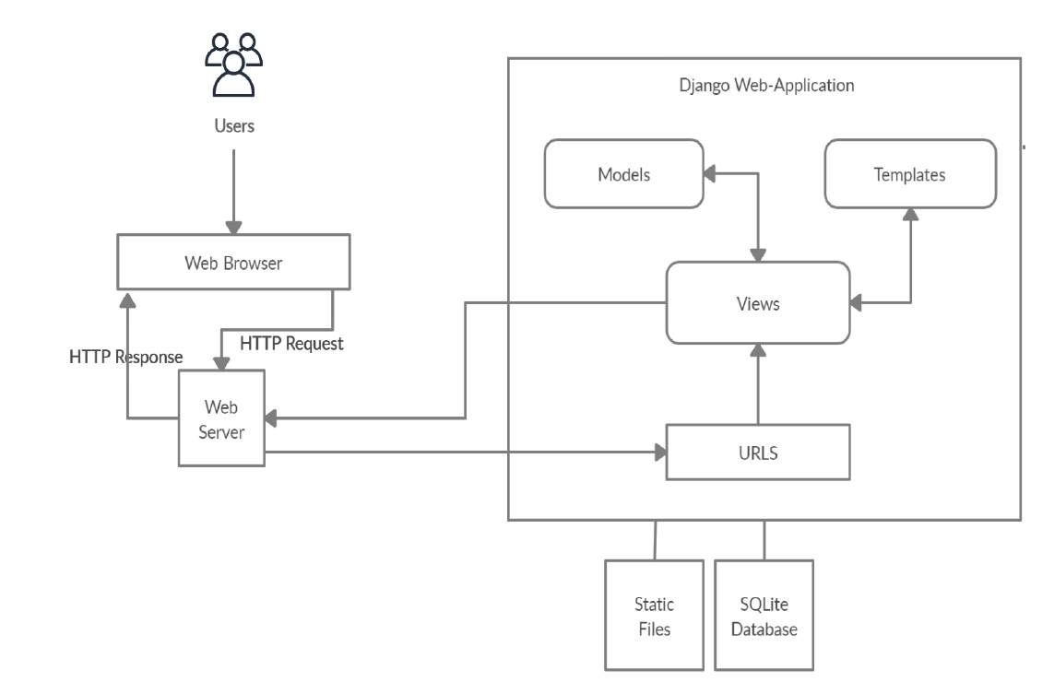

Slide 11
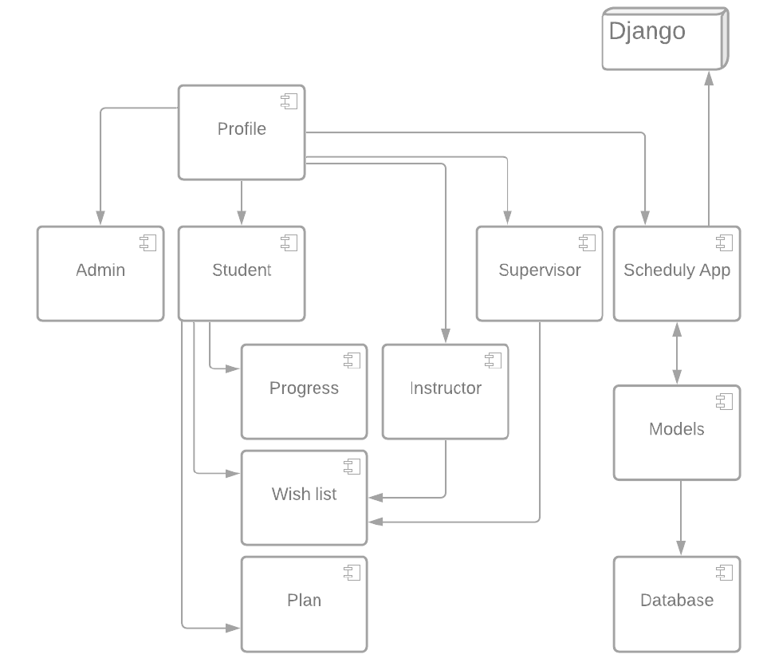

Slide 12
System Design
Student
Instructor
Supervisor
Admin

Slide 13
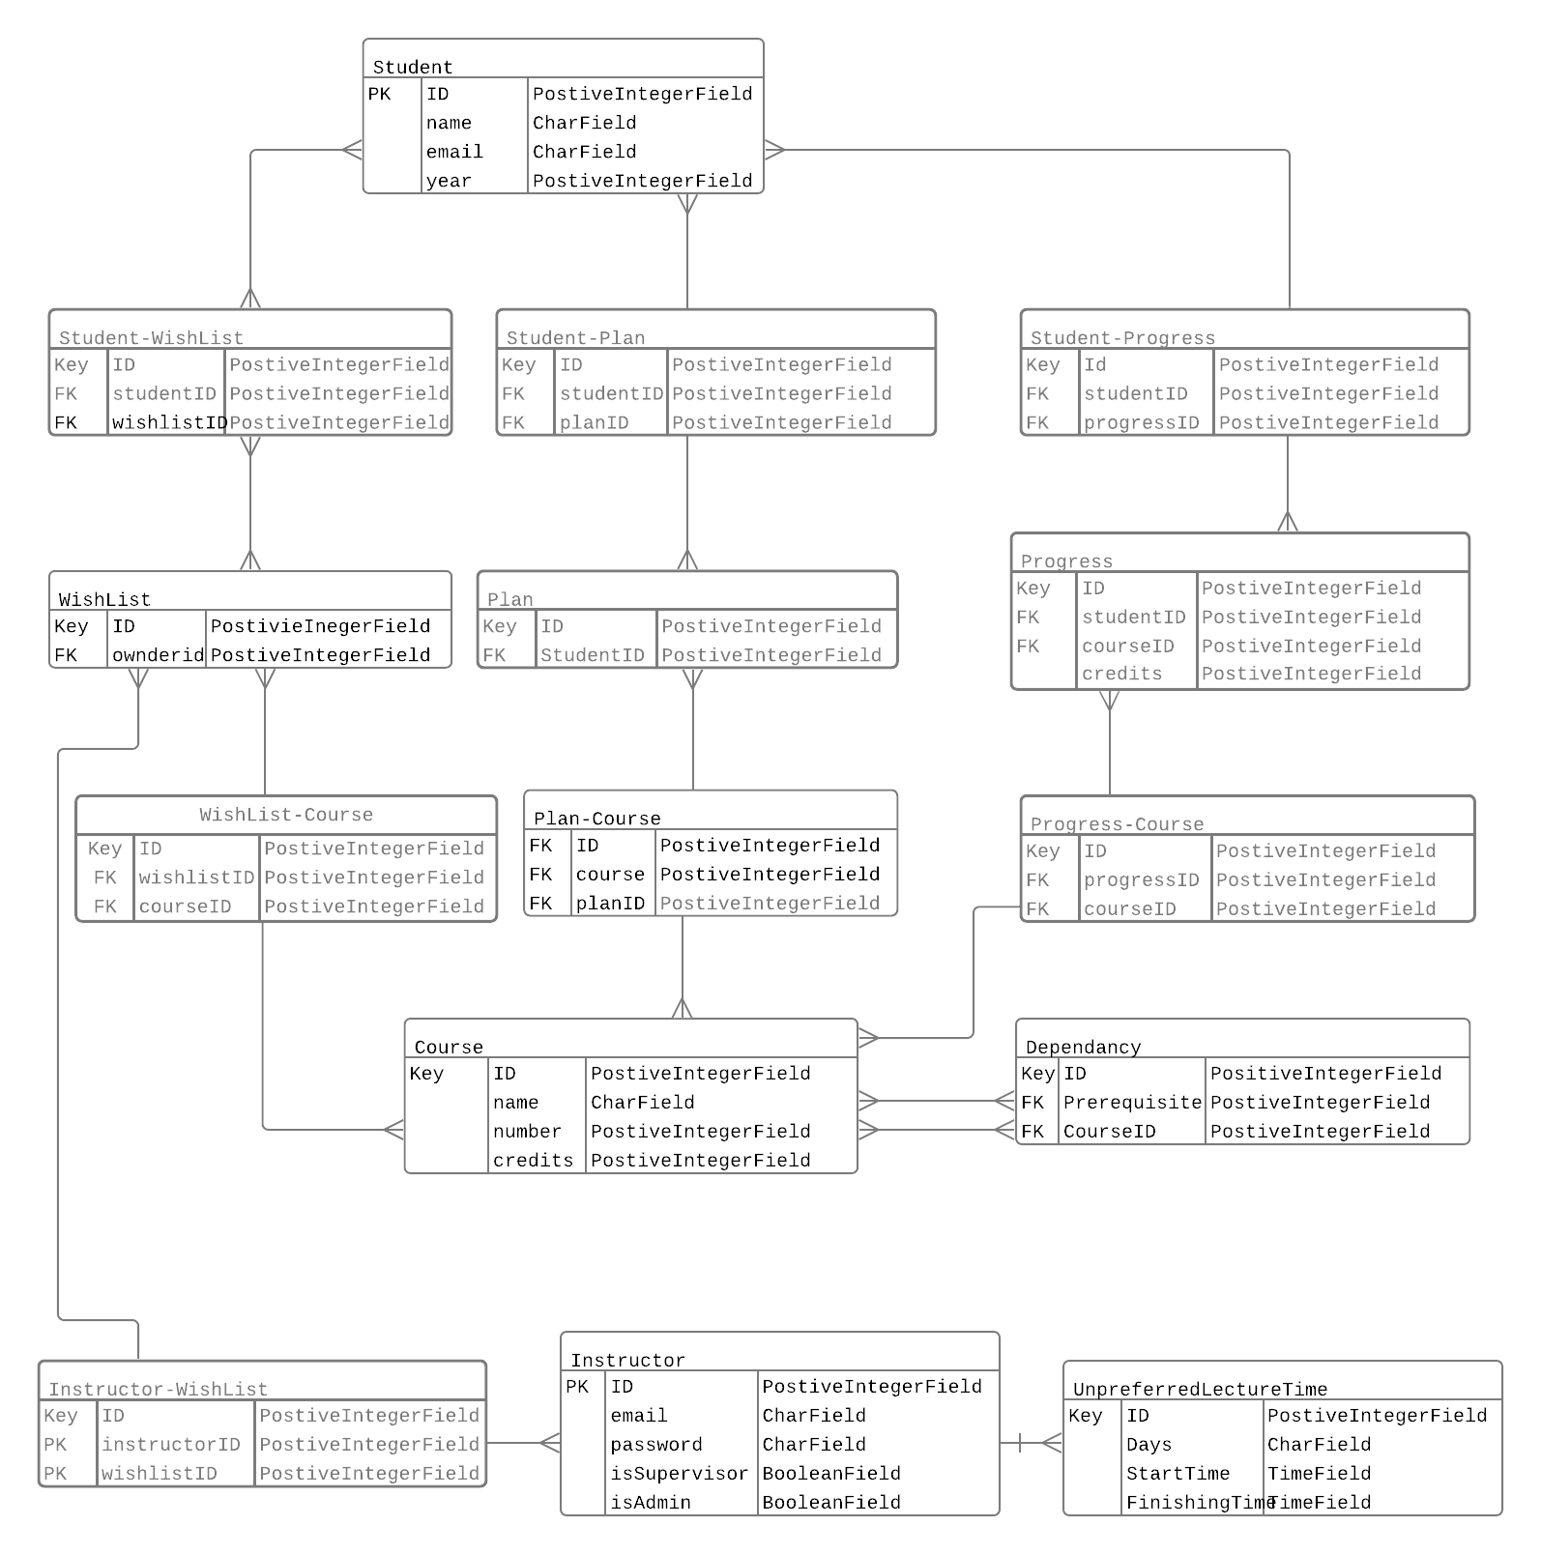

Slide 15
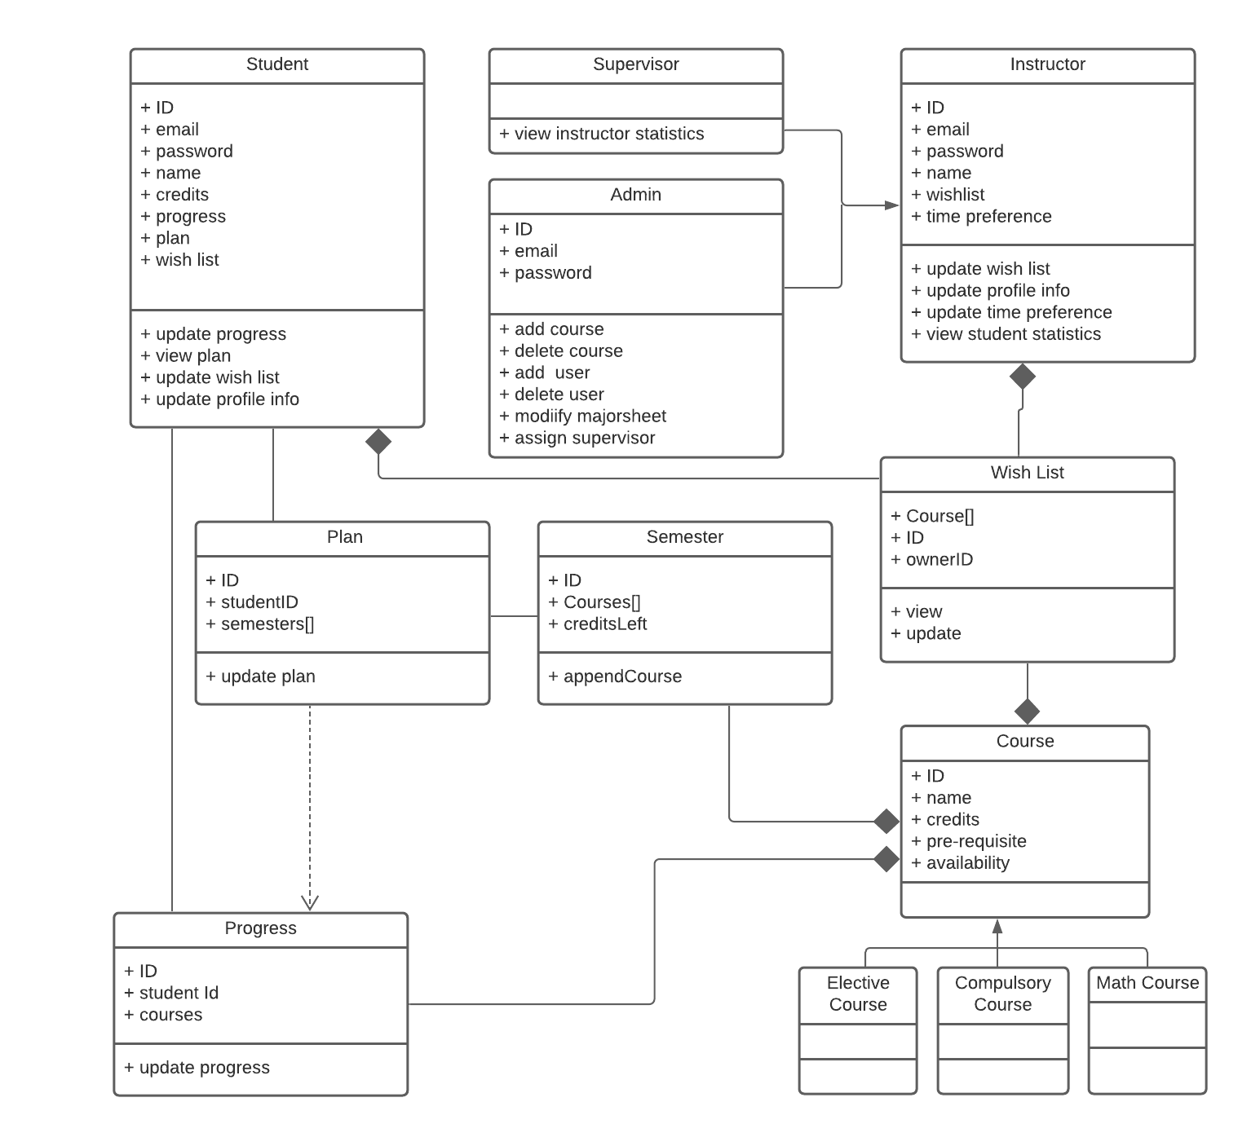
Class Diagram

Slide 16
Interface
The interface design followed the eight golden rules of interface design

Slide 17
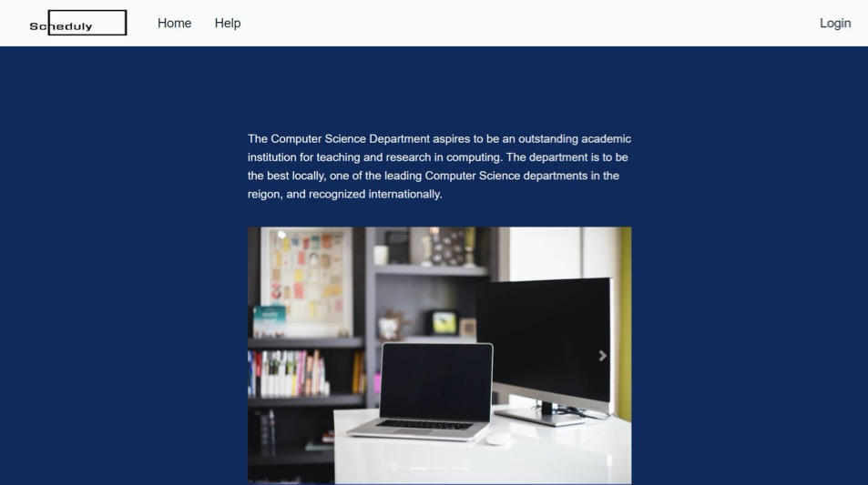
1. Consistency 2. Keep users in control 3. Reducing short-memory load 4. Seek Universal Usability

Slide 18
1. Consistency 2. Keep users in control 3. Reducing short-memory load 4. Seek Universal Usability

Slide 19
1. Consistency 2. Keep users in control 3. Reducing short-memory load 4. Seek Universal Usability

Slide 20
1. Consistency 2. Keep users in control 3. Reducing short-memory load 4. Seek Universal Usability

Slide 21

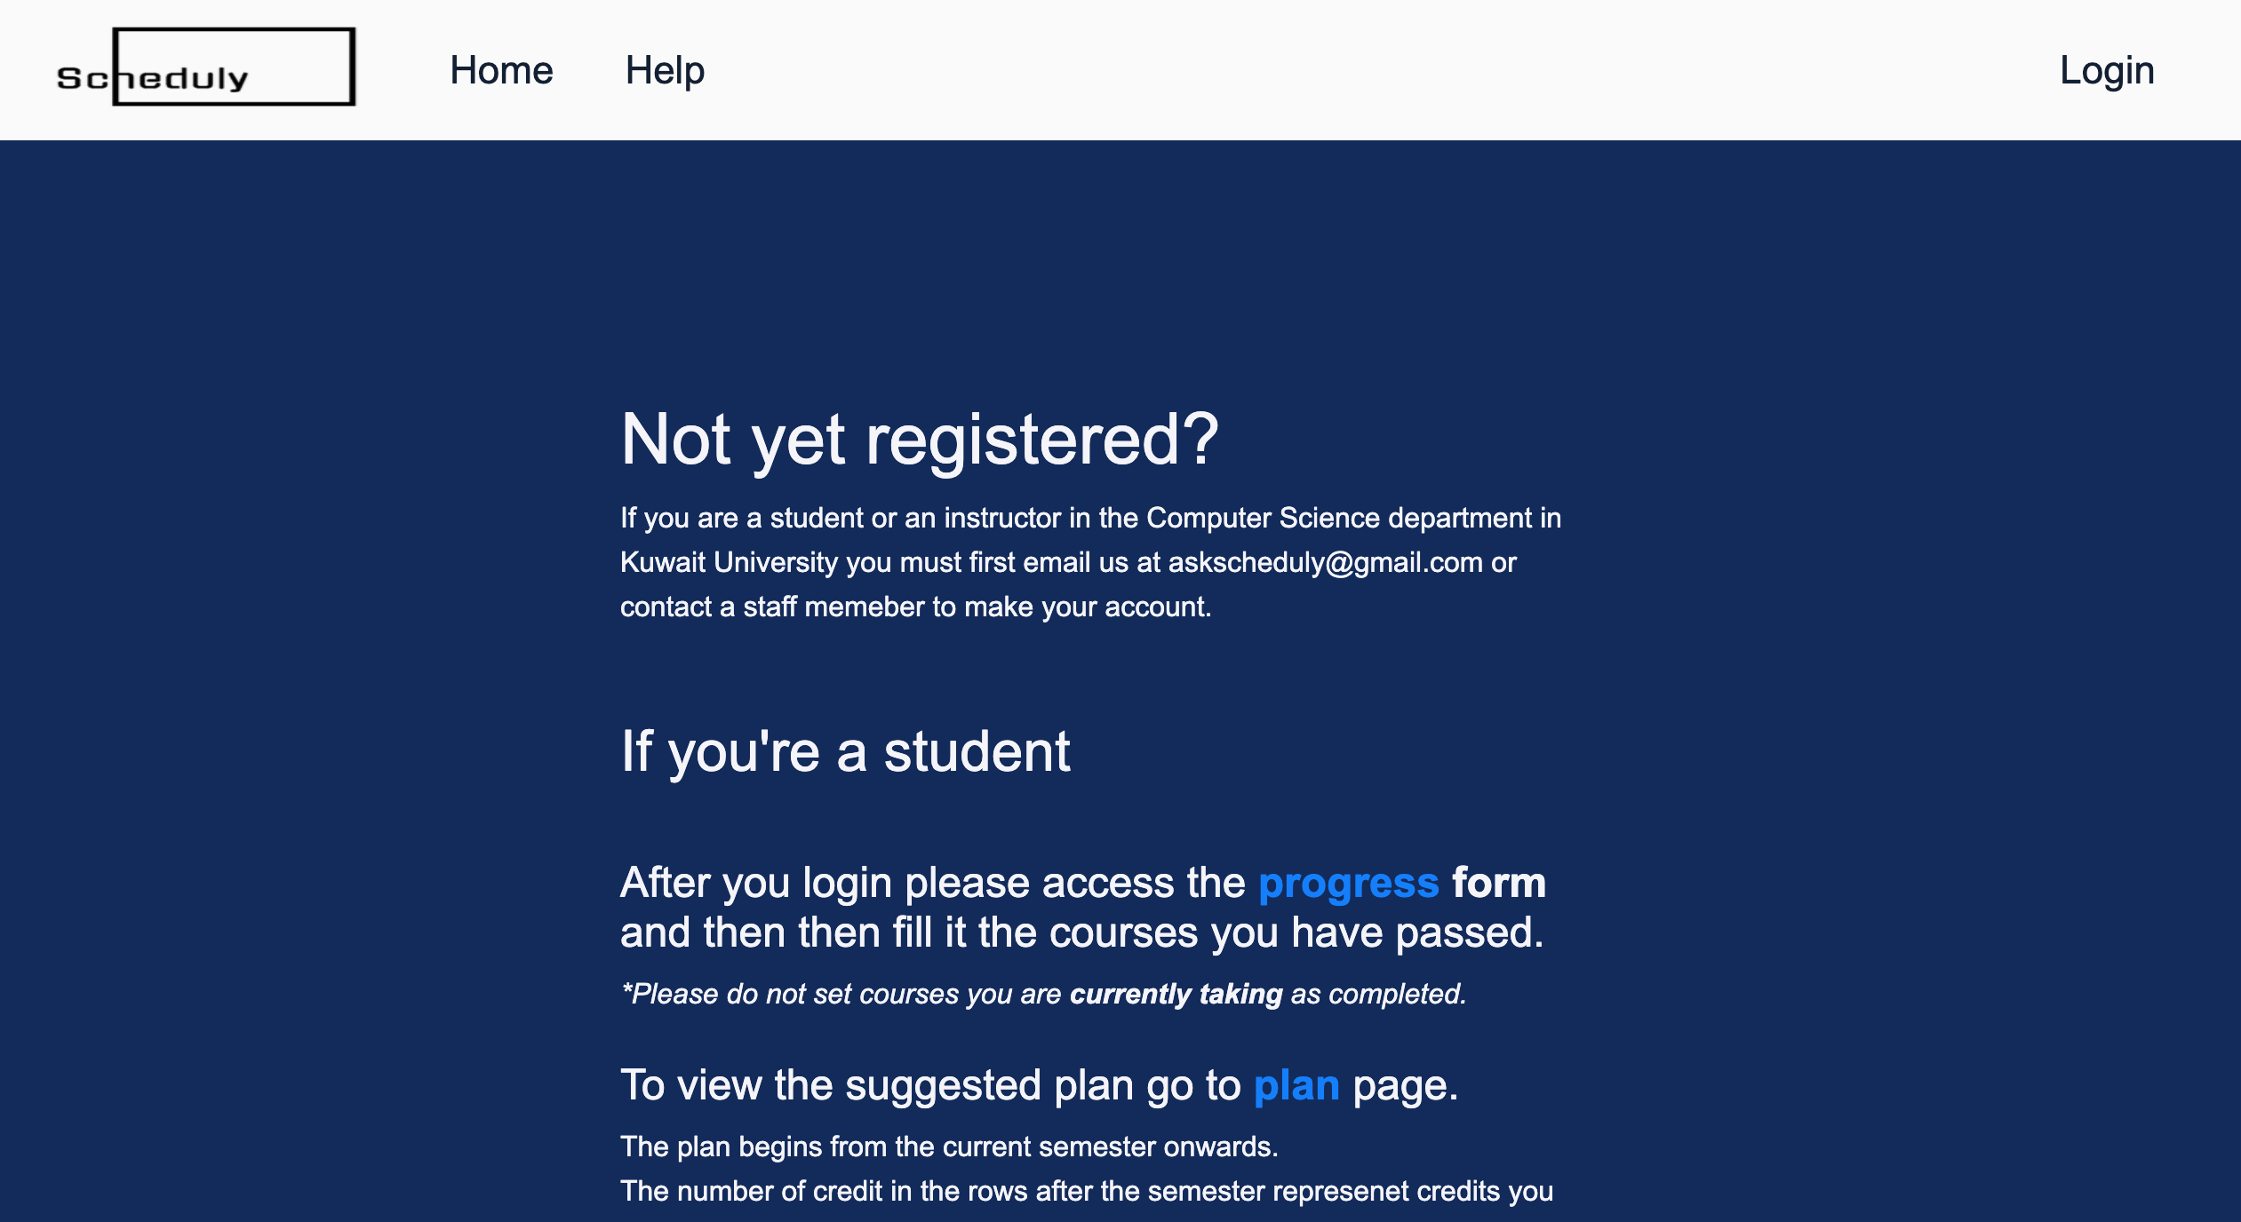
5. Offer Informative Feedback 6. Easy Reversal of Action 7. Closure Dialogs 8. Prevent Errors
9. Help and documentation

Slide 22
5. Offer Informative Feedback 6. Easy Reversal of Action 7. Closure Dialogs 8. Prevent Errors
9. Help and documentation

Slide 23
Algorithms
Statistics
Input: Wish list of students
Output: Number of students for each course
Plan
Input: list of courses & student finished courses & student’s credits
Output: list of courses divided by semester

Slide 24
Algorithms

Slide 25
Algorithms

Slide 26
Implementation Frameworks and Tools:
Django:
Django Model Layer
Django View Layer
Django Template Layer
Django built-in template tags
Django build-in authentication system.
Django built-in QuerySet
Django Database SQLite
Django built-in library Forms
Django build in library FormSet
Django built-in admin librar
Python OOP programming
Python OOPS itertools
Bootstrap

Slide 27
Testing
Framework and Tools
Django testing library
Selenium Framework
Apache Jmeter

Slide 28
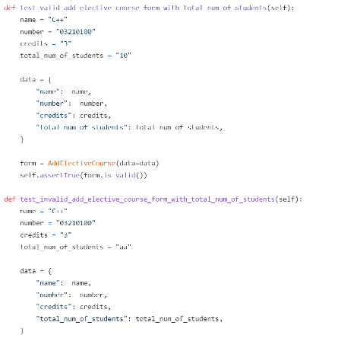
Testing: 1. Unit Testing
85 Tests

Slide 29
Testing: 2. Integration Testing
45 Tests

Slide 30
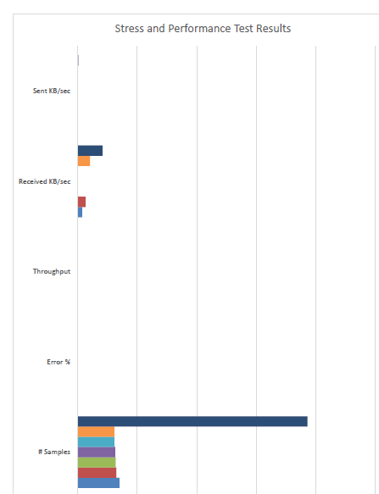
Testing: 3. Stress and Performance Testing

Slide 31
Conclusion and Lessons Learned
Scheduly is the system this team developed with software engineering methodologies.
The project went through many phases including Planning, Analysis, Design, implementation, testing, and deployment.

Slide 32
Conclusion and Lessons Learned
Many risks were faced
The team strived to solve a problem in today's department of Computer Science in Kuwait University.
The web-app developed with the powerful Python programming language.

Slide 33

Questions
Notes:
<Rhian>
Thanks very much for coming along to hear us today, we would be pleased to take any questions you may have.

